Slide 1

PREDICTING FLIGHT DELAYS
IN THE UNITED STATES
CAPSTONE PROJECT IN BUSINESS ANALYTICS
Harshitha Mayya, Sofiya Koretskaya,
Navya Gangadharappa Ramesh, and Yada So

Slide 2
Today’s Topics
Introduction and Problem Statement
Literature Review
Description of Datasets and Data Exploration
Data Pre-processing
Data Mining Models and Evaluations
Domain Knowledge and Methodological Contributions
Conclusion

Slide 3

Introduction and Problem Statement
Source:
US Department of Transportation published on November 2020
Overview on Data:
Approximately 200 million domestic US flights from 2018 to 2020.
Attributes: Dataset encompasses fundamental flight statistics. Includes information on date, time, destination, and departure airports.
For the six US airlines that operate, we developed machine learning models. We will additionally investigate if our outcomes can be enhanced following dataset balancing via SMOTE and Naïve Random Over-Sampling.
The dataset utilizing allows us to estimate the probability that a flight will arrival on schedule.

Slide 4
Literature Review
Flight delay prediction from spatial and temporal perspective
Authors: Qiang Li, Ranzhe Jing (NOVEMBER 2022)
Dataset: In this paper, the data encompassing 762,415 samples connecting 260 airports during June to August 2016.
Algorithms: It uses Random Forest as a classifier alongside the Complex Network Theory and LSTM units to handle this challenge by taking both geographical and temporal views on flight delay prediction.
Key feature: The proposed model’s accuracy is 92.39%.

Slide 5
2. Investigating the Costs and Economic Impact of Flight Delays in the United States
Author
Classification
California State University, San Bernardo
Written by: Ashmith Anupkumar, Robert W. Hall and David L. Peterson.
This study investigates the impact of flight delays in the US. Analyzing data from multiple sources, they estimate both direct (e.g., fuel costs) and indirect (e.g., lost productivity) costs. Cost for flight delays adds up to 31.2 billion dollars annually.
Application
Investments in infrastructure and improved management practices can help reduce delays.
Airlines should consider compensating passengers for the indirect costs they incur through hotel vouchers, free transportation, access to lounges/comfortable areas while they wait.

Slide 6
3. A data mining approach to flight arrival delay prediction for American Airlines
Author
Problem Statement & Algorithm
- Author: Chakrabarty N.
- Organization: Jalpaiguri Government
Engineering College in India
- Publication Year: 2019
- Predicting delay of flights operated by American
Airlines in top 5 busiest airports in the U.S.
- Classification by Gradient Boosting Classifier
Dataset & Algorithm
Result
- Datasets: flight data from U.S.
Department of Transportation from 2015 to
2016
- Data imbalance: SMOTE
- Accuracy of training data: 86.68%.
- Accuracy of test data: 85.73%

Slide 7
Description of Datasets and Data Exploration
Data Source and Size:
Obtained flight data from U.S. Department of Transportation.
Used a smaller IBM sample dataset (2018 – 2020) to overcome computer processing limitations.
Focused analysis on flight data from six specific airlines.
Weather Integration:
Gathered weather data from NOAA's Integrated Surface Database (ISD).
Acknowledged weather's impact on flight delays.
Merged flight and weather data for a holistic analysis
Airlines | Southwest, Delta, American Airlines, Republic, JetBlue, and Alaska
Time Period | Jan 2018 – Dec 2020
Attributes of Flight Data | Year, Month, Day of Month, Day of Week, Airlines, Origin Airport, Destination Airport, Departure Time Bulk, Arrival Time Bulk
Attributes of Weather Data | Windspeed, Cloud height, Visibility, Temperature, Rain, Snow
Classification (Dependent Variable) | Arrival Delay (1 if the flight is delayed for 15 minutes or more, and 0 otherwise)

Slide 8
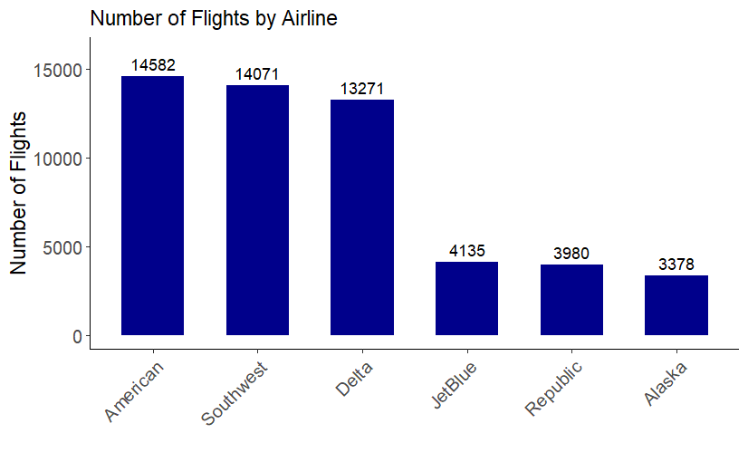
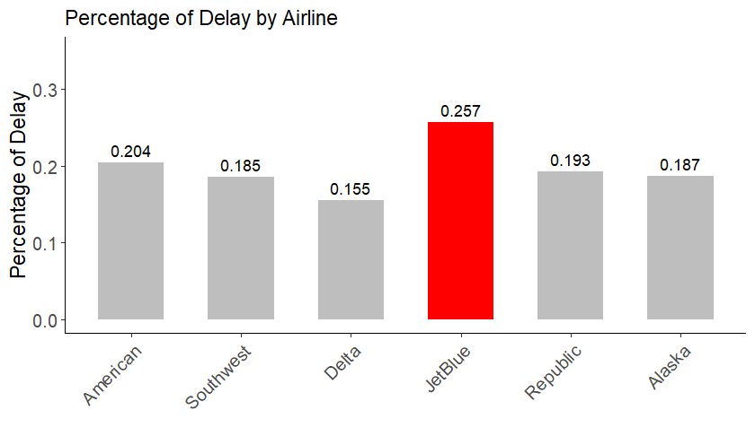
Description of Datasets and Data Exploration
Graph 1 shows the number of flights operated from 2018 to 2020 for each airline selected.
Graph 2 shows the percentage of delays by each airline.

Slide 9
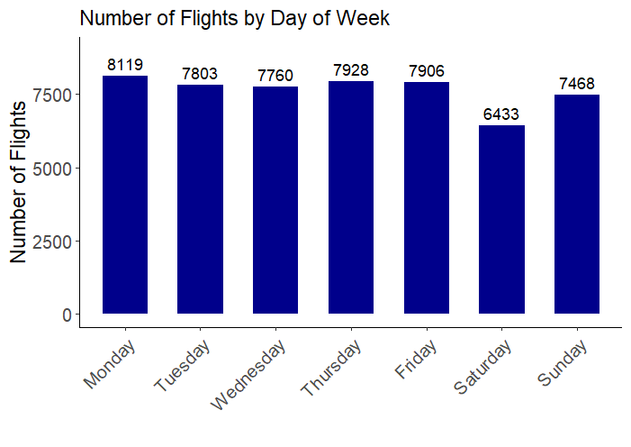
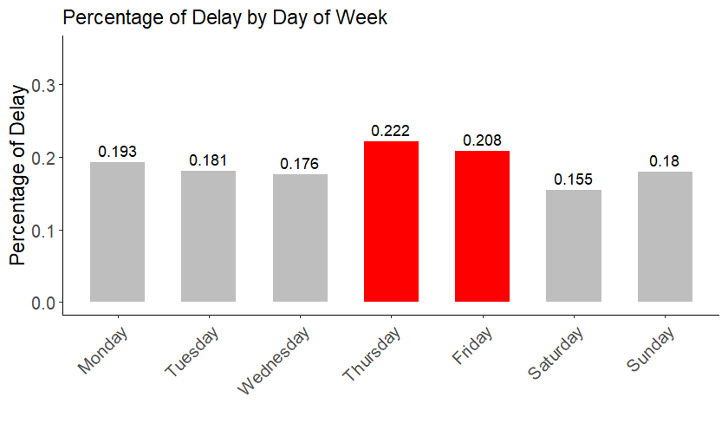
Description of Datasets and Data Exploration
Graph 3 shows the number of flights by day of the week
Graph 4 shows the percentage of delays by day of the week.

Slide 10
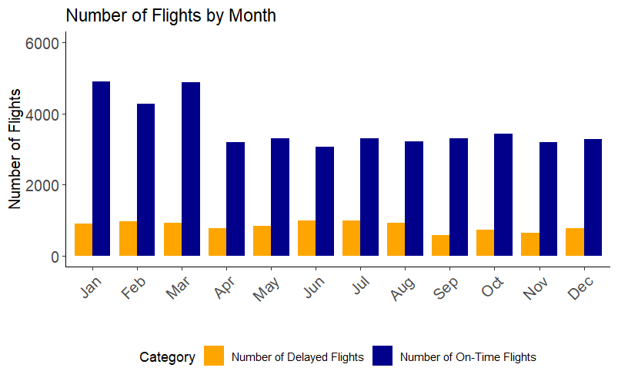
Description of Datasets and Data Exploration
Graph 5 shows the number of flights and delays per month. We can infer that the number of flights is more in the winter quarter, especially in January and March.

Slide 11
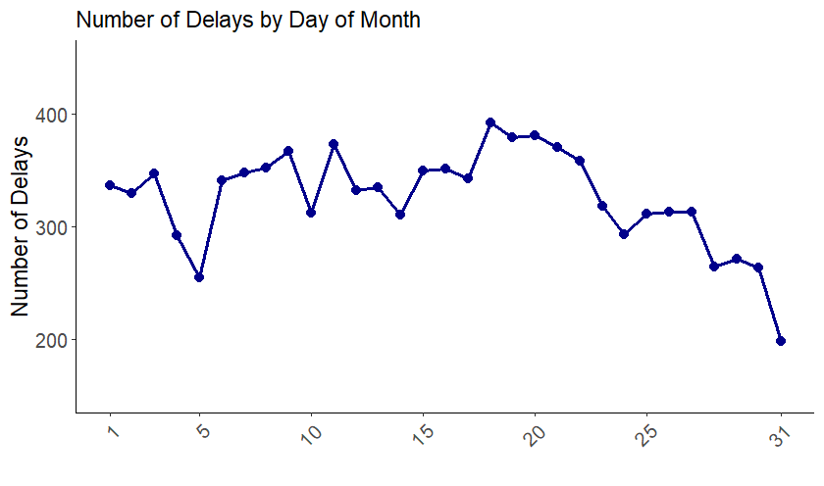
Description of Datasets and Data Exploration
Graph 6 shows the number of delays for day of the month. We can infer that the number of delays is more during the 18th – 20th day of the month. Both customers and the airlines/airports can plan better during these days well in advance.

Slide 12
Data Pre-Processing
Weather Data
Windspeed, cloud height, visibility, temperature, rain, and snow information
Missing values replaced by mode values
Flight Data
Year, Month, Day of Month, Day of Week, Airlines, Origin Airport, Destination Airport, Departure Time Bulk, Arrival Time Bulk
Dependent Variable: Arrival Delay (1 if delay >= 15 mins, otherwise 0)
Select only 6 airlines and 39 airports to reduce the number of samples
Data Merging
Merge weather data with flight data using ‘Airport’, ‘Date’, and ‘Hour of Day’ columns
53,413 rows, 178 attributes, and 1 dependent variable (Arrival Delay) after converting categorical variables to dummy variables

Slide 13
Data Pre-Processing
Data Imbalance
43,318 flights were not delayed while only 10,095 flights were delayed.
Naïve Random Over-Sampling and SMOTE to increase delayed flights from 10,095 to 43,318
Feature Reduction
178 attributes. 12 are continuous variables, while 166 are dummy variables
Feature selection by feature importance and PCA to reduce number of features from 178 to 50
Model Dataset
Reduce the number of features first, then balance the dataset? Or balance the dataset first?
Naïve Random Over-Sampling or SMOTE?
Feature Importance or PCA?
PCA with Naïve Random Over-Sampling produces the best results and their order didn’t change the results.

Slide 14
Data Mining Models and Evaluations
Random Forests
Dataset with PCA only: accuracy from test data is 81%.
Applying Naïve Random Over-Sampling: accuracy increases to 98%.
Decision Tree
Dataset with PCA only: accuracy from test data is 70%.
Applying Naïve Random Over-Sampling: accuracy increases to 86%.
Logistic Regression
Dataset with PCA only: accuracy from test data is 81%.
Applying Naïve Random Over-Sampling: accuracy decreases to 60%.
Naïve Bayesian
Dataset with PCA only: accuracy from test data is 80%.
Applying Naïve Random Over-Sampling: accuracy increases to 62%.

Slide 15
SVM
Best Estimator
The best model has the following parameters:
Kernel: rbf
Gamma: 0.5994842503189409
C: 27.825594022071257
Best Score:
Dataset pre-processed using PCA
The model was trained on a dataset of only 10 candidates, and it was able to achieve an accuracy of over 99%.
Total Run Time:
13,568.68 seconds (about 4 hours) to complete the random search.

Slide 16
Neural Networks
Best Estimator:
The most effective MLP classifier is configured with:
Activation function: 'tanh'
Hidden layer sizes: (125, 150)
Maximum number of iterations: 21,000
Best Score:
The MLP classifier, utilizing the above hyperparameters, achieved the highest cross-validated score of 0.89.
Total Run Time:
The Randomized Search process, spanning 4930.51 seconds (approximately 1.5 hours), reflects the exhaustive exploration of the specified hyperparameter space.

Slide 17
Data Mining Models and Evaluations
No. | Model | Mean Score (Fold = 5) | Computation Time (seconds)
1 | SVM | 0.9941 | 10,000
2 | Random Forests | 0.9852 | 300
3 | Neural Networks | 0.8953 | 250
4 | Decision Tree | 0.8867 | 21
5 | Logistic Regression | 0.6129 | 1
6 | Naïve Bayesian | 0.6115 | 1

Slide 18
Domain Knowledge
Operational Resource Allocation:
Predictive models empower airlines to strategically allocate staff and optimize ground services.
Enables proactive resource management to handle expected delays efficiently.
Streamlined Pre-flight Process:
Pre-emptive approach ensures smoother check-in, security, and boarding processes.
Enhances operational efficiency and contributes to passenger satisfaction.
Advanced Communication Strategies:
Predictive capabilities facilitate effective communication for ground and cabin crews.
Enables adept navigation of potential delays and management of passenger expectations.
Air Traffic Management:
Flight delay prediction plays a strategic role in air traffic management.
Allows real-time adjustments to flight routes and dynamic reassignment of slots.
Collaborative Decision-making:
Enhances communication between air traffic control, airlines, and airports.
Enables a coordinated response to predicted delays, optimizing route utilization.
Resilience and Adaptability:
Proactive stance fortifies the air traffic system against compounding effects of delays.
Fosters resilience and adaptability, minimizing the likelihood of subsequent delays.

Slide 19
Methodological Contributions
Dataset Overview:
Original dataset with 178 features - 12 continuous variables, 166 dummy variables.
Categorical variables - Year, Month, Airlines, Origin Airports, Destination Airports, time blocks) - converted to dummy variables.
Data Imbalance:
Number of Delays : 10,095 samples
Number of Non-Delays : 43,318 samples
Feature Reduction and Balancing Dilemma:
Faced challenges in deciding the sequence: balance dataset first or reduce features?
We considered Naïve Random Over-Sampling or SMOTE for balancing, feature selection, or Principal Component Analysis for feature reduction.
Decision-Making Process:
Utilized Random Forests model on various dataset candidates.
Employed K-Fold cross-validation to evaluate results.
Identified Naïve Random Over-Sampling with Principal Component Analysis as the optimal combination for achieving the highest mean scores.

Slide 20
Conclusion
Data Imbalance:
Naïve Random Over-Sampling > SMOTE
Feature Reduction:
Primary Component Analysis > Feature Importance
ML Algorithms:
Accuracy: SVM > Random Forests
Computation Time: Random Forests >>> SVM
Future Study:
Full dataset from the Department of Transportation: more than 200 million rows
Dataset in our model: around 53,000 rows
Cloud computing to train ML models can yield more accurate results
Flight data from a different country

Slide 21
Appendices (Dataset)
No. | Description of Dataset | Score (Cross Validation)
1 | Original Dataset | 0.81
2 | Dataset with Naïve Random only | 0.97
3 | Dataset with SMOTE only | 0.87
4 | Dataset with PCA only | 0.81
5 | Dataset with PCA first, then Naïve Random | 0.98
6 | Dataset with PCA first, then SMOTE | 0.89
7 | Dataset with Naïve Random first, then PCA | 0.98
8 | Dataset with SMOTE first, then PCA | 0.88
9 | Dataset with feature selection only | 0.81
10 | Dataset with FS first, then Naïve Random | 0.97
11 | Dataset with FS first, then SMOTE | 0.85
12 | Dataset with Naïve Random first, then FS | 0.97
13 | Dataset with SMOTE first, then FS | 0.86

Slide 22
Appendices (Random Forests)
Results from Training Data
Arrival Delays | Precision | Recall
0 | 1.00 | 1.00
1 | 1.00 | 0.98
Accuracy |  | 1
Results from Test Data
Arrival Delays | Precision | Recall
0 | 0.99 | 0.98
1 | 0.93 | 0.97
Accuracy |  | 0.98

Slide 23
Appendices (Decision Tree)
Results from Training Data
Arrival Delays | Precision | Recall
0 | 1.00 | 0.99
1 | 0.97 | 0.99
Accuracy |  | 0.99
Results from Test Data
Arrival Delays | Precision | Recall
0 | 0.99 | 0.83
1 | 0.57 | 0.98
Accuracy |  | 0.86

Slide 24
Appendices (Logistic Regression)
Results from Training Data
Arrival Delays | Precision | Recall
0 | 0.87 | 0.60
1 | 0.27 | 0.63
Accuracy |  | 0.60
Results from Test Data
Arrival Delays | Precision | Recall
0 | 0.88 | 0.59
1 | 0.27 | 0.65
Accuracy |  | 0.60

Slide 25
Appendices (Naïve Bayesian)
Results from Training Data
Arrival Delays | Precision | Recall
0 | 0.87 | 0.62
1 | 0.27 | 0.60
Accuracy |  | 0.62
Results from Test Data
Arrival Delays | Precision | Recall
0 | 0.87 | 0.62
1 | 0.27 | 0.61
Accuracy |  | 0.62

